Slide 1
Global climate change
Team: D-3nviromentalist
Team Name: Stephanie R, Rosario C, Jon L, Michael L, David S, Cesar R.

Slide 2
Introduction
As we looked at different topics we came across an article on Global Climate Change. The charts in the article and the topic intrigued us to pursue further.
The majority of our data from is from nasa.gov as txt files and converted to csv.
We researched several js library and settled for slick
Notes:
Insert a map of your country.

Slide 3
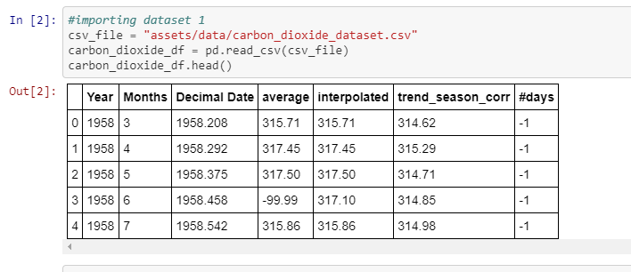
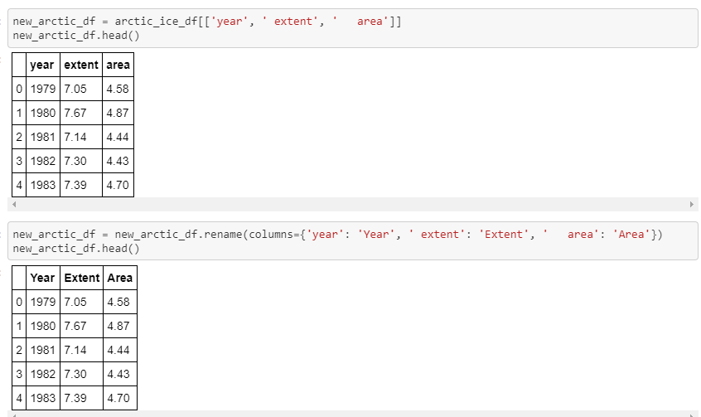
Clean up
We Imported our data in pandas and started to clean the data.
Dropped unnecessary columns
Renamed columns due to long name and blank spaces that caused issues adding to a data frame.
Notes:
Insert a picture of one of the geographic features of your country.

Slide 4
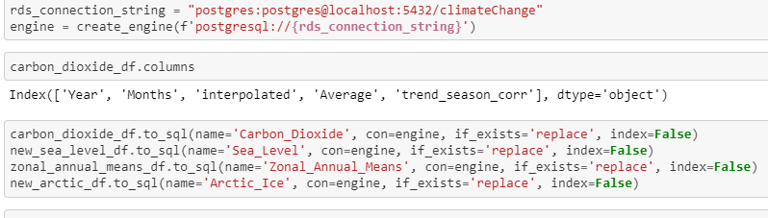
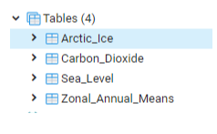
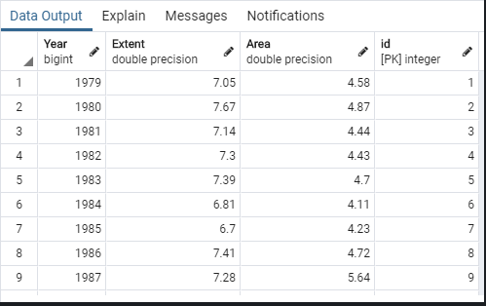
Postgres SQL
Once data was cleaned we connected our pandas data in Postgres SQL.
Tables were created in Postgres and Primary Keys were added.
Notes:
Insert a picture illustrating a season in your country.

Slide 5
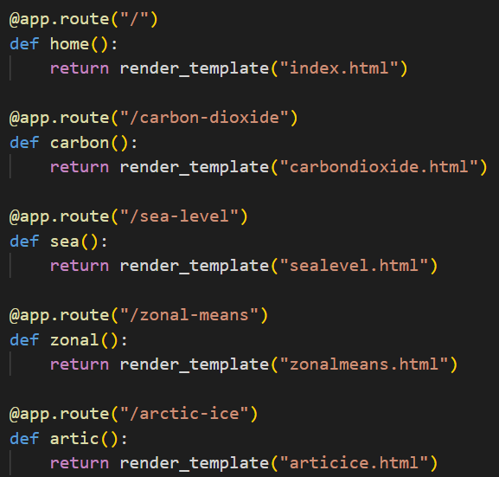
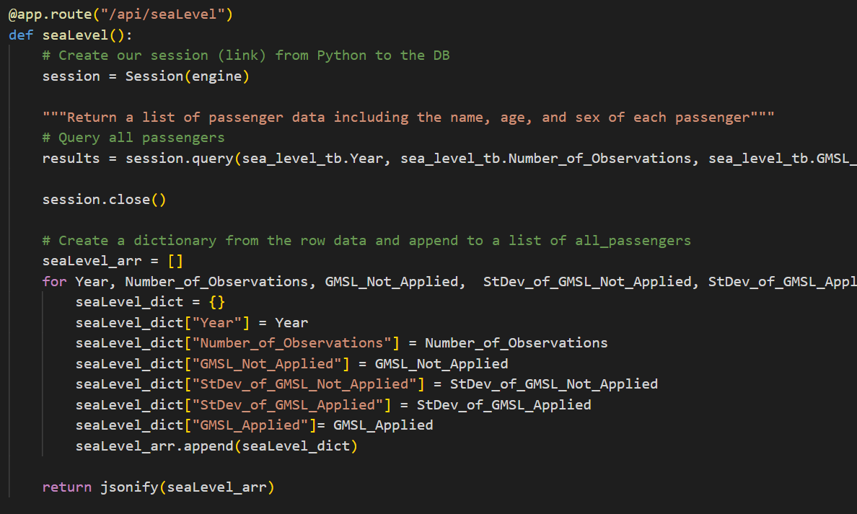
Creating Python flask
All necessary libraries were imported to render each template and also created API routes to JSONIFY our data to easily work with our data.
Notes:
Insert a picture of an animal and or plant found in your country.

Slide 6
Issues Encountered
When trying to get data to be saved to the flask we received an error message “Attribute Error key”. We were able to solve by adding Primary key to the data.
Rending charts on our HTML page became an issue, a recommend fix was to use incognito mode.

